Slide 1


JavaScript
Sipan Sahakyan

Slide 2
Callback Hell
setTimeout(() => {
console.log(10);
setTimeout(() => {
console.log(20);
setTimeout(() => {
console.log(30);
}, 1000)
}, 1000)
}, 1000)

Slide 3
XMLHttpRequest
const request = new XMLHttpRequest();
request.open('GET', 'https://restcountries.com/v3.1/name/' + countryName);
request.send();
request.addEventListener('load', () => {
console.log(request.response);
// some code after getting data from server
})

Slide 4
Promise
before future value is available
Async task has already finished
Pending
Async task
Settled
Fulfilled
Rejected

Slide 5
Promisifying setTimeout
const wait = function (seconds) {
return new Promise(function (resolve) {
setTimeout(resolve, seconds * 1000);
});
};
wait(1)
.then(() => {
console.log('1 second passed');
return wait(1);
})
.then(() => {
console.log('2 second passed');
return wait(1);
})
.then(() => console.log('3 second passed'))

Slide 6
Async / Await
async function f() {
let promise = new Promise((resolve, reject) => {
setTimeout(() => resolve("done!"), 1000)
});
let result = await promise; // wait until the promise resolves (*)
alert(result); // "done!"
}
f();

Slide 7
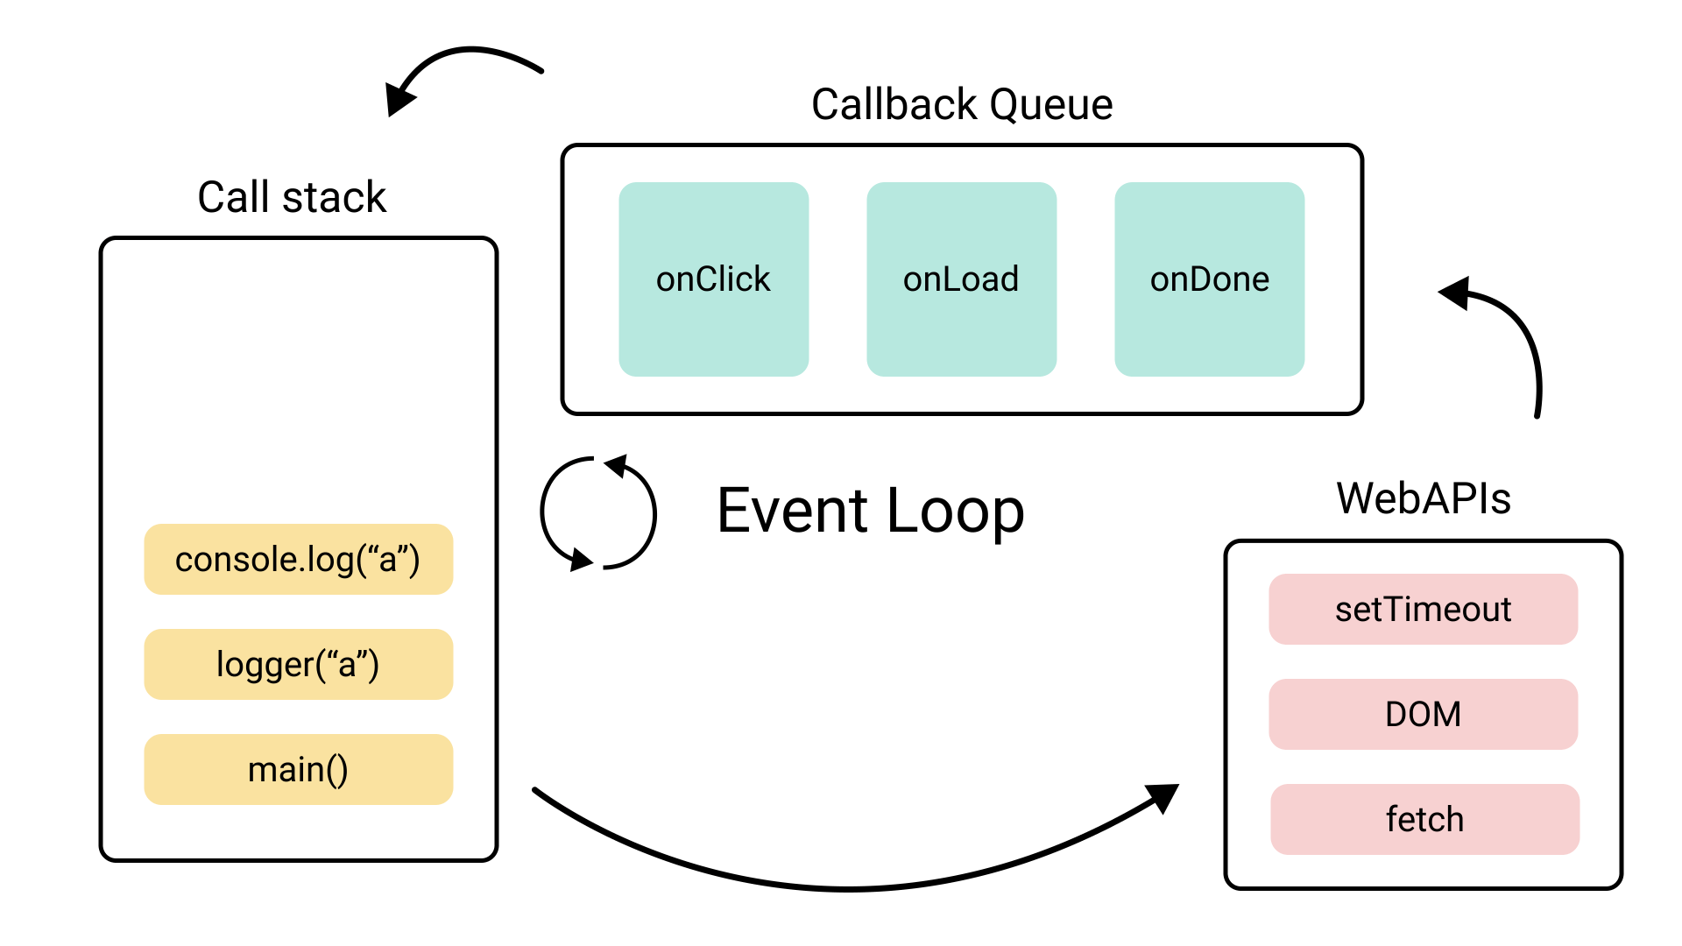
Event Loop

Slide 8
Consumers: then, catch
promise.then(
function(result) { /* handle a successful result */ },
function(error) { /* handle an error */ }
);

Slide 9
Example
let promise = new Promise(function(resolve, reject) {
setTimeout(() => resolve("done!"), 1000);
});
// resolve runs the first function in .then
promise.then(
result => alert(result), // shows "done!" after 1 second
error => alert(error) // doesn't run
);

Slide 10
Cleanup: finally
new Promise((resolve, reject) => {
/* do something that takes time, and then call resolve or maybe reject */
})
// runs when the promise is settled, doesn't matter successfully or not
.finally(() => stop loading indicator)
// so the loading indicator is always stopped before we go on
.then(result => show result, err => show error)

Slide 11
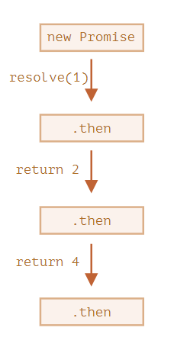
Promises chaining
new Promise(function(resolve, reject) {
setTimeout(() => resolve(1), 1000); // (*)
}).then(function(result) { // (**)
alert(result); // 1
return result * 2;
}).then(function(result) { // (***)
alert(result); // 2
return result * 2;
}).then(function(result) {
alert(result); // 4
return result * 2;
});

